Slide 1
INTRODUCTION TO NODEMCU

Slide 2
Agenda:
About Nodemcu
About Arduino IDE
About digital and analog pins
About sensors
About esaycodeging

Slide 3
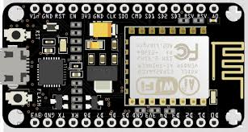
About Nodemcu
NodeMCU is an open-source Lua based firmware and development board specially targeted for IoT based Applications. It includes firmware that runs on the ESP8266 Wi-Fi SoC from Espressif Systems, and hardware which is based on the ESP-12 module.

Slide 4
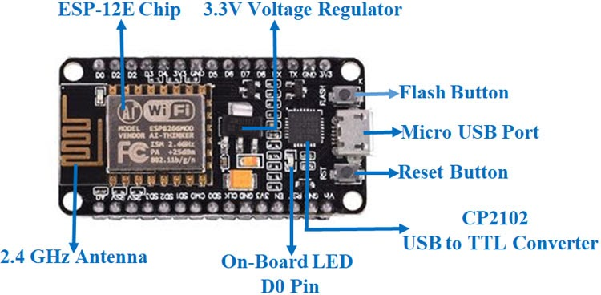

Slide 5
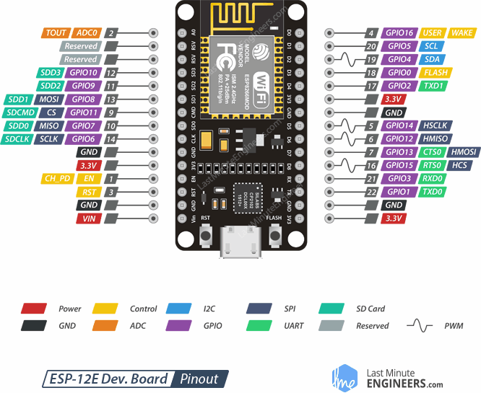
About Nodemcu digital and analog pin
When performing INPUT and OUTPUT tests on the pins, we obtained the following results:
digitalWrite did NOT work with GPIOs 6, 7, 8, 11,and ADC (A0)
digitalRead did NOT work with GPIOs 1, 3, 6, 7, 8,11, and the ADC (A0)
analogWrite did NOT work with GPIOs 6, 7, 8, 11,and ADC (A0) (GPIOs 4, 12, 14, 15 have hardware PWM, and the others are by software)
analogRead worked only with the ADC (A0),6, 7, 8, 11 do NOT work for the above four commands

Slide 6
ABOUT SENSORS
Digital and analog sensors
Electronic sensors or electrochemical sensors in which data conversion and data transmission takes place digitally are called as digital sensors. The digital sensor consists of majorly three components: sensor, cable, and transmitter. In digital sensors, the signal measured is directly converted into digital signal output inside the digital sensor itself.
There are different types of sensors that produce continuous analog output signal and these sensors are considered as analog sensors. This continuous output signal produced by the analog sensors is proportional to the measurand. There are various types of analog sensors; practical examples of various types of analog sensors are as follows: accelerometers, pressure sensors, light sensors, sound sensors, temperature sensors, and so on.

Slide 7
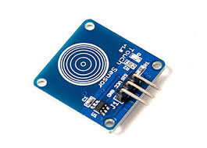
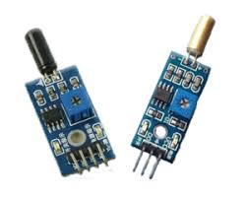
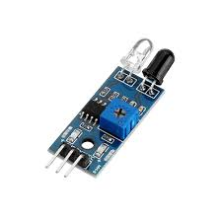
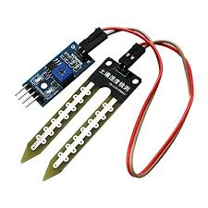
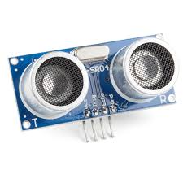
Digital sensors
Digital sensors
Analog sensors

Slide 8
EASY CODING
Easy coding is a site that helps people by making it easy to code by making the code available in the block format that is similar to Google’s blockly.

